Slide 1
When is a species endangered?
Population trends, dispersion, vulnerability and endangered designation.

Slide 2
Excerpt from: Saving the Red-eyed Vireo
The time to extinction equals zero. This expression is of a calculus concept: a reflection on that point on a graph when the rate of population decline approaches infinity. My first practical experience with the idea came from the remote island of Guam, where a colleague had described for me his experience in trying to save the Guam Flycatcher. From the time of developing a plan to captive breed birds to actually implementing it, a matter of a few months, the species had gone from saveable to extinct. Unknown to him, the rate of population decline had reached during those months infinity. Free fall.
The Red-eyed Vireo is the second-most common forest bird in southern New England. Yet, its future is not secure. Deforestation, forest fragmentation, urbanization and tree disease are all potentially catastrophic for populations of the species.

Slide 3
Objectives
Distinguish among categories of endangerment and between rarity and endangerment.
Understand the role of population dispersion in assessing conservation concern.
Assess the conservation implications of models explaining dispersion.
Examine population trends and the underlying causes of these trends.

Slide 4
Federal Definitions
Rare- population densities are among the lowest in a community. A species may be rare throughout its range or in a portion of it.
Endangered- a species (or subspecies) in imminent danger of extinction. Such species have low population densities or a small total population. The latter may occur in an isolated habitat or on an island.
Threatened- a species that is likely to become endangered within the foreseeable future throughout all or a significant portion of its range.
Candidate- a species for which sufficient information exists on biological status and threats to propose it as endangered or threatened, but for which listing is precluded by other higher priority listing activities.

Slide 5
IUCN Red List
The International Union for Conservation of Nature has developed a Red List, which similarly ranks species as to their conservation concern. Their categories are:
Extinct- no surviving individuals.
Extinct in the wild- survives only in captivity.
Critically endangered- populations face imminent extinction.
Endangered- populations and their trajectory place them in danger of becoming extinct.
Vulnerable- populations or their habitats are vulnerable to declines leading to endangerment.
Near threatened- population and their habitats exhibit potential for becoming endangered in the future.
Least concern- no significant threats.
Data deficient- inadequate information exists.
Details of the criteria are in IUCN Red List Categories and Criteria.
Osmoxylon mariannense is an endangered, endemic tree of the tropical Pacific island of Rota, where it is restricted to cloud forest.

Slide 6
NatureServe Categories
NatureServe conservation categories are an outgrowth of work done by the Nature Conservancy to assist with targeting land protection efforts. Their categorization includes:
Geographic levels: global, national and subnational.
Conservation categories:
Critically imperiled- 5 or fewer occurrences or 1,000 or fewer individuals.
Imperiled- 6 to 20 occurrences or 1,001 to 3,000 individuals.
Vulnerable- 21 to 100 occurrences, or 3,001 to 10,000 individuals.
Apparently secure- uncommon but with some cause for long-term concern; 101 or more occurrences or 10,001 or more individuals.
Secure- common, widespread, abundant, and lacking major threats.
X- Presumed extinct or extirpated; extinction is global (range-wide), whereas extirpation applies to loss within a particular area although still extant elsewhere.
H- Possibly extinct or extirpated.
R- Recorded within a nation or subnation, but local status not yet determined.
Heritiera longipetiolata is known only from the southern Mariana Islands of the tropical Pacific.

Slide 7
Rarity vs. Endangerment
A characteristic of most communities is that a few species are abundant whereas many have densities at the lowest levels in the community- these may reasonably be called rare.
The degree to which this occurs is a function of the components of species diversity- species richness (i.e. species number) and species evenness.
Both these quantities vary among communities, with variation in evenness determining the proportion of a community that is rare.
Forest birds of southern New England demonstrate this pattern (next slide).
Rarity may be related to species’ microhabitat specializations, the distribution of a landscape’s microhabitats, competitive interactions, predator-prey interactions and such phenomena as reaching physiological tolerances at range limits.
The Ovenbird is the most abundant breeding bird in contiguous southern New England forests.

Slide 9
Rarity vs. Endangerment- continued
Tropical forests, for example (right), are typically comprised of a great diversity rare tree species. A hectare can have 100 species.
In these forests, rarity can be an evolutionary strategy for avoiding seed predators and disease.
Rare species often exhibit characteristics of r-selected species. That is, they produce fewer offspring, but they invest greater energy into each to ensure its survival.
Hence, rarity often does not equal endangerment.

Slide 10
Population Dispersion
Particularly at the local level, rarity can be related to the distribution of microhabitats, which can determine the spacing patterns of species.
Spacing- how individuals are distributed across a landscape; refers to the dispersion pattern of individuals in a population. Types:
Clumped- individuals are clustered in groups.
Random- no spacing pattern is apparent.
Spaced- individuals are regularly spaced across a landscape (typical of desert plants).
The aerial infrared image at right illustrates the dispersion of individual plant species within a tidal marsh. As is often the case, the dispersion is clumped, with clumps in large part related to microhabitat conditions- in this case the depth of tidal flooding.
Competitive interactions among plants as well as temporal changes in habitat conditions also appear to play roles, with the extent of the clumps changing over time.
This image has been computer-analyzed to highlight the distribution of individual plant species, from common to rare: green = Scirpus, deep blue = Acorus, pale violet = Typha, pale blue = Carex, deep violet = Peltandra.

Slide 11
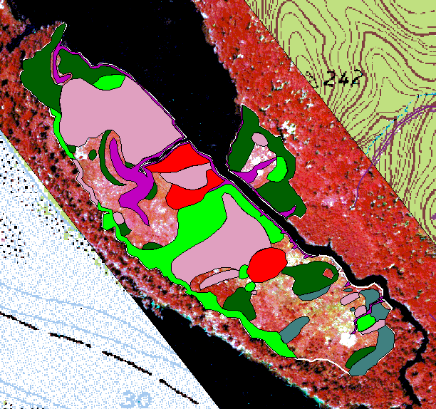
Metapopulations
Several models have been proposed to explain how species distribute themselves across landscapes. Two related ones are the metapopulation and source-sink models.
These discrete, clumped populations in the image are referred to as metapopulations- sets of geographically isolated populations that occupy patches of suitable habitat.
Metapopulations maintain contact with each other, to a greater or lesser extent, by dispersal of individuals (or seeds) from one to another.
Small, isolated populations in sub-optimal habitats are typically not self-sustaining (sink populations), but instead are maintained via immigration from populations of more optimal habitats that produce excess offspring (source populations).
How we view conservation concern over population clumps is affected by whether such populations are sources or sinks.
This tidal marsh, just km away from the last, exhibits a differing pattern of population dispersion. In this marsh, Peltandra is more widespread.

Slide 12
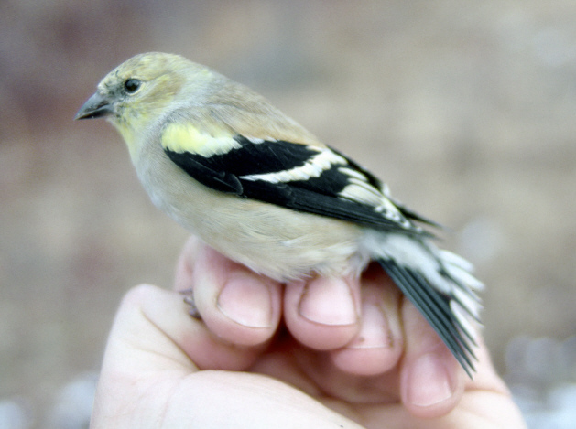
Factors Controlling Distributions
At the local level, how we view rarity and conservation concern also is affected by the factors that control distributions. These include:
Physiological tolerances- based on the internal functioning of the body.
Ecological tolerances- based on the such factors as the habitat needs of a species and interspecific interactions.
Dispersal ability- as we have seen, the ability of a species to colonize new areas is a significant factor.
Population pressure- as highlighted by the source-sink model, when a population grows beyond an area’s ability to support it, individuals tend to disperse to new areas, to a greater or lesser degree of success.
American Goldfinches tend to concentrate southern New England populations at low elevations in winter, likely because the species maximizes its probability of winter survival by moving to the less energetically expensive milder climate there.

Slide 13
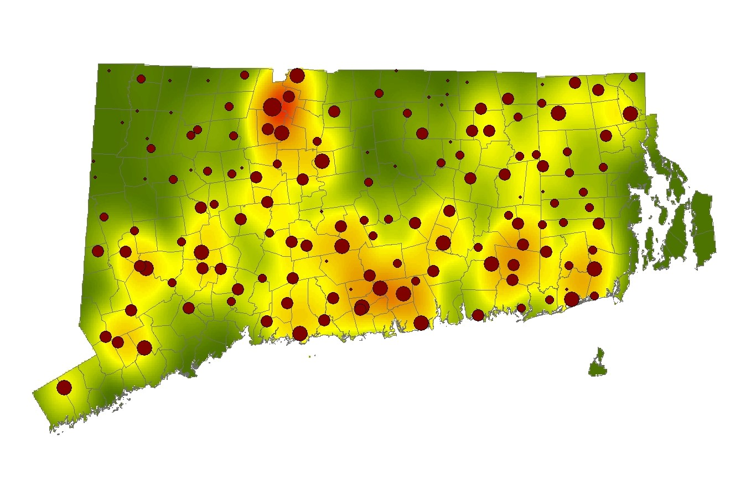
Seasonal American Goldfinch Populations
Summer
Winter
Summer populations are more uniformly distributed than in winter, when populations become particularly dense (yellow to orange) in low elevation portions of southern New England.

Slide 14
Elevations of Southern New England

Slide 15
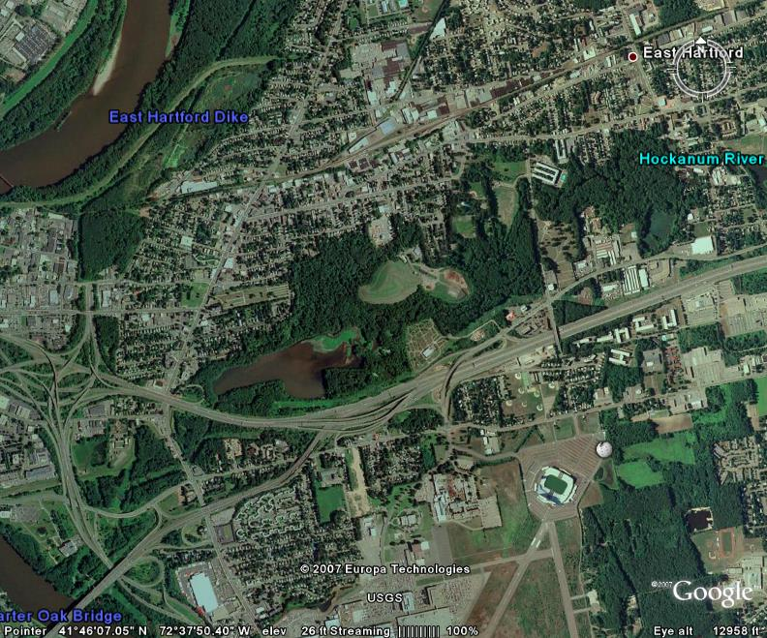
Extensions of the Metapopulation Model
The ideal free distribution model extends the metapopulation concept by asserting that individuals disperse from patches of high to low quality habitat.
The expectation is that the highest quality patches are colonized first and the lowest quality ones are colonized last.
It also assumes that as a population grows within a patch, habitat quality declines are resources in it are consumed.
Example: Forest fragments are well-documented as being lower quality habitats than contiguous forest for birds.
They have a greater area/edge ratio, which leads to greater predator densities.
Food density has also been documented to be lower.
Consequently, reproductive success is low.
To the extent that this model applies, it affects interpretation of species’ rarity.
The most abundant bird species of southern New England forest, the ground-nesting Ovenbird, was virtually absent from this mature forest fragment in East Hartford, CT.

Slide 16
Landscape Model
A further extension asserts that the quality of a habitat is affected by the nature of adjacent habitats, which influences populations of species within the habitat.
For example, forest adjacent to intensively managed agricultural land would be expected to have a lower quality than forest next to an undisturbed field.
Consequently, the rarity of a species living next to disturbed habitat must be viewed differently than that of a species where no disturbance occurs.

Slide 17
Population Trends
Assessment of the conservation concern associated with a rare population is greatly enhanced by examining data on population trends.
The shape of a population trajectory is often non-linear.
In the case of declines, concave declines indicate a slowing rate of decline, convex declines indicate an increasing rate and linear declines indicate a constant rate.
Quadratic models often best approximate rates of decline, although exponential models and power functions also can fit data well.
In the case of the Guam Flycatcher (right), a convex decline reached its vertical asymptote, such that the rate of decline approached infinity. The consequence was that numbers dropped so fast that the species disappeared before a planned captive breeding program could be implemented.
The rate of population decline by the Guam Flycatcher reached its vertical asymptote in 1983, resulting in the population disappearing within a matter of months.

Slide 18
Breeding Bird Survey Population Trajectories
Indigo Bunting breeding populations have undergone a long-term, linear decline.
Eastern Towhee breeding populations have undergone a long-term, parabolic decline.
Although both these species are still widespread and common, their long-term North American population trajectories indicate a cause for conservation concern and suggest that efforts be made to identify causes of the declines.

Slide 19
Assessing Causes of Declines
Key to stemming and reversing declines is identifying the causes of the declines.
Doing so often must rely upon circumstantial evidence, as gathering experimental data can be impractical and time consuming at a time when responding immediately can be critical.
Case study: the Rota White-eye:
With only limited data, the rate of population decline was initially computed to be linear: final population = 9.93 – 0.10 (initial population).
The decline was coincident with a population buildup by the introduced and predatory Black Drongo. Drongos were common where white-eyes were absent and they were rare where remaining white-eyes were present.
Hence, a control program was instituted where drongos were removed particularly where white-eyes were present. This program ran out of funds, however, so was discontinued.
This is the first known photograph of a Rota White-eye.
Despite this, since the 1990s the population trend has turned out to be non-linear. For no certain reason, it is now increasing.

Slide 20
Population Cycles
Population declines are not in themselves definitive evidence of conservation concern.
Many species undergo population cycles that can be related to such factors as variation in food availability, disease, weather patterns and predation.
Cycles are typically 5-10 years in length, but much longer cycles also may occur.
Winter populations of Yellow-rumped Warblers may undergo such cycles, as is suggested by long-term Christmas Count data.

Slide 21
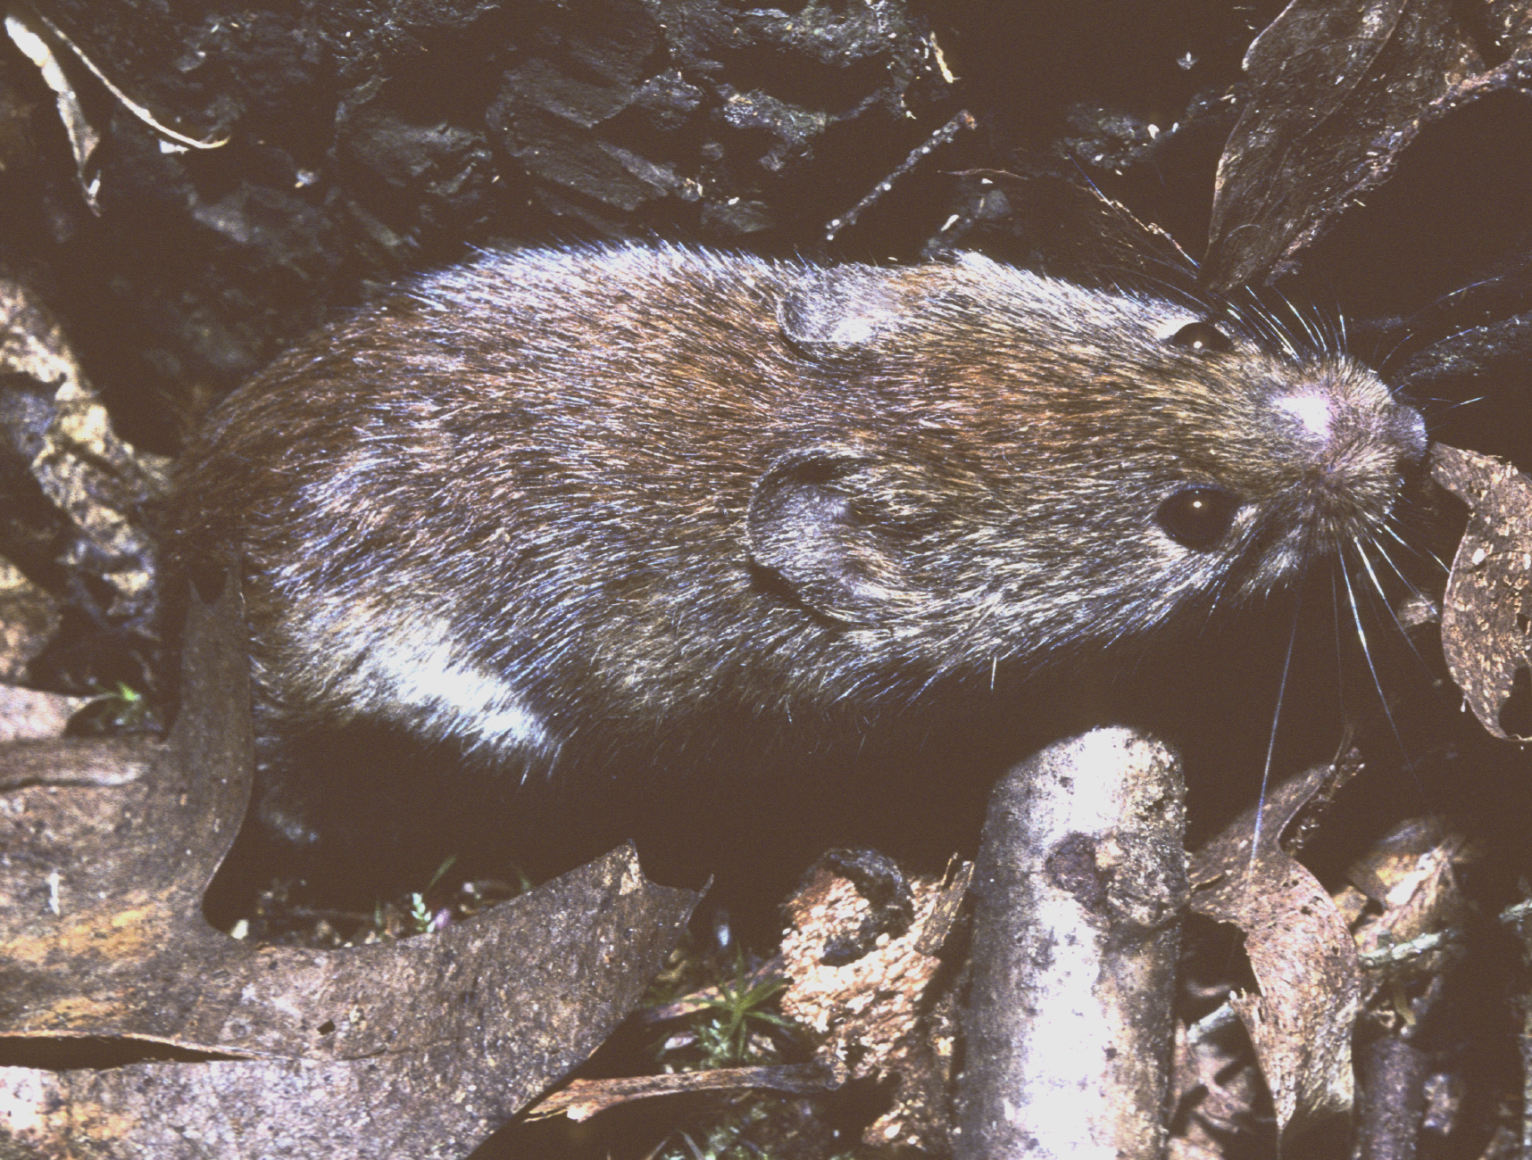
Population Cycles-continued
Like most small mammals, the Red-backed Vole (left) undergoes annual and long term population cycles.
In the temperate zone, often 90% or more of small mammal populations experience winter mortality.
Depending on factors like disease, predator pressure and intraspecific competition for food, populations may also increase or decrease over a series of years.
Years of extremely high populations may be followed by population crashes.
Notes:
21

Slide 22
Excerpt from: Conservation of Endangered White-eyes in the Tropical Pacific.
There is presently no proof for any factor being the principal cause of the decline of Z. c. rotensis. At this point, it is also unlikely that experimental data can be gathered that will definitively demonstrate the causative agent of the decline. Once a population has collapsed to a tiny remnant, all causes of decline become important, and any number of stochastic events having nothing to do with the initial cause of the decline may drive further declines. Only reasonable assessment of existing circumstantial patterns and developing a conservation program based on counteracting the most likely causes of decline hold much hope for keeping this white-eye from slipping into extinction.

